Slide 1
Effects of Anthropogenic Noise Pollution on Behavioral and Physiological Stress Responses in Hairy Shore Crabs (Hemigrapsus oregonensis)
By: Tyler Lloyd, Ethan Audia, Dominic Delaat, Andrew Margolis

Slide 2
Why should we care?
Coastal soundscapes are changing
Marine noise levels have approximately doubled each decade in many regions (Jalkanen et al. 2022)
Anthropogenic noise is increasing globally through:
Shipping
Coastal construction
Recreational boating
Waterfront concerts and events
Noise pollution is now recognized as an important environmental stressor here in the PNW (Holt et al. 2026)
Invertebrates' response to this stressor is understudied (Aimon et al. 2021)
Ship noise was concluded to increase respiration in European green crabs (Birch et al., 2025).
Knowledge Gap: How does acute anthropogenic noise exposure affect shore crabs' physiology?

Slide 3
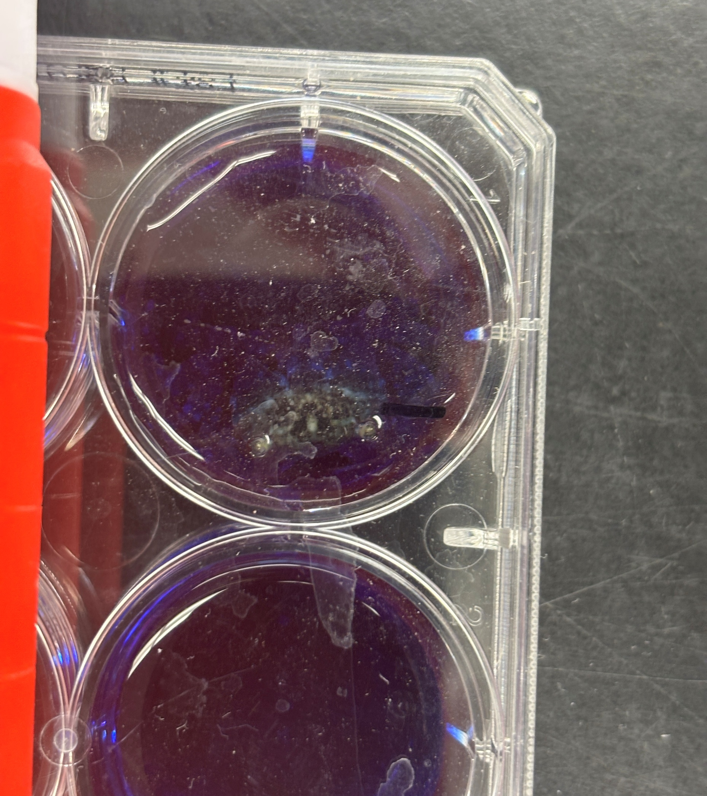
Research Hypothesis
Does acute anthropogenic noise exposure alter behavioral or physiological stress responses in hairy shore crabs?
Hypothesis
Noise-exposed crabs will exhibit:
Increased respiration
Increased glucose mobilization
Decreased righting behavior indicating elevated fight or flight stress response.

Slide 4
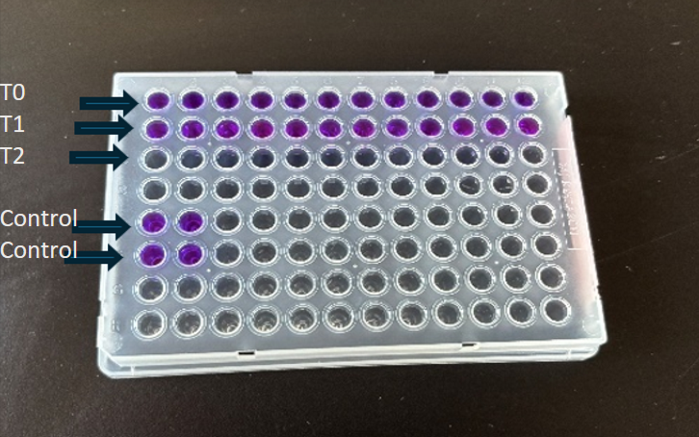
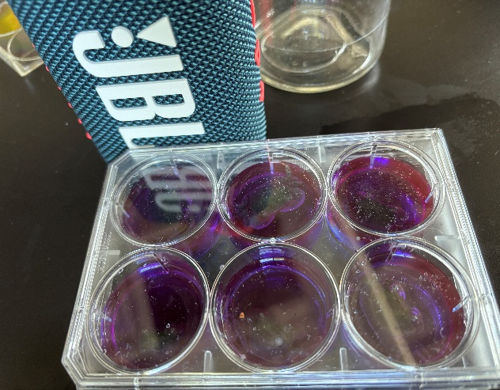
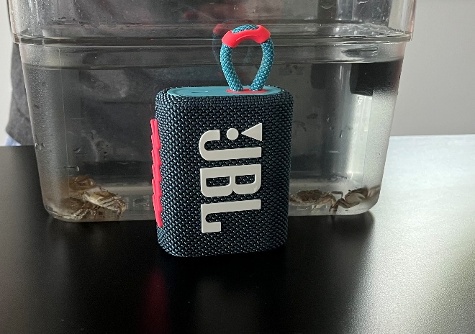
Methods Setup
Control (quiet) group
Noise treatment group (~75 dB EDM)
Measurements taken over 3 weeks
2-hour interval, 1x per week
Week 1: n = 12, Week 2 & 3: n = 10
Data collection began after 1 hour of noise exposure
Respiration measured at T0 (1:00), T1 (1:30), and T2 (2:00)

Slide 5
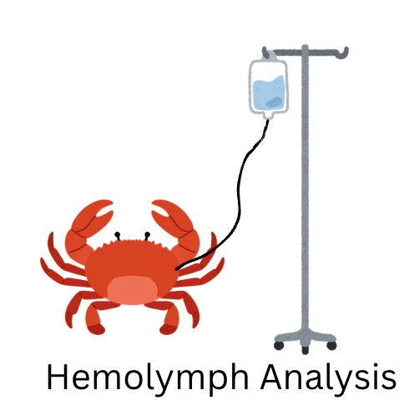
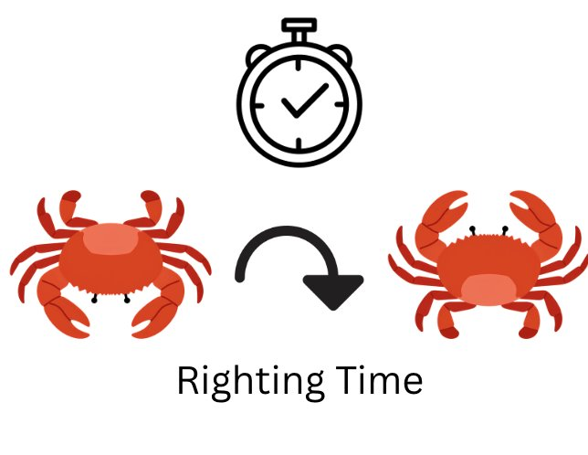

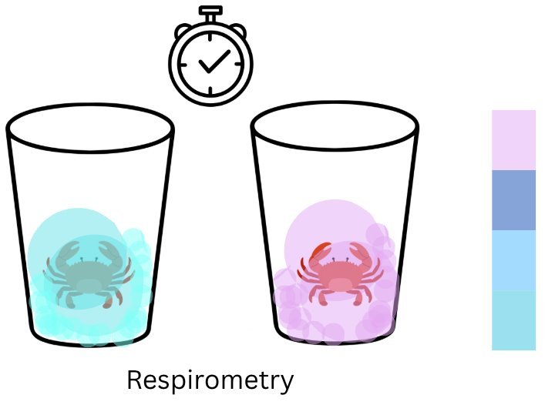
JBL
Treatment
10c | 35 ppt
Control
10c | 35 ppt

Slide 6
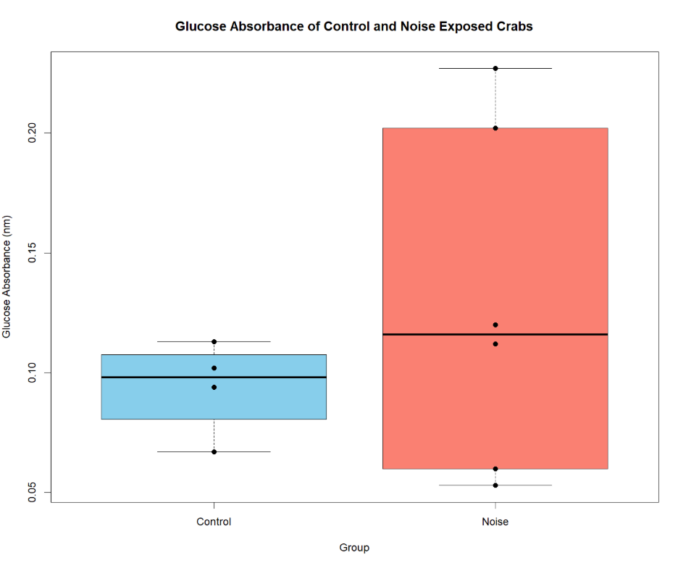
Glucose Assay
Glucose absorbance reflects amount of glucose present in hemolymph
Low absorbance = low glucose
No significant treatment effect.
Noise-exposed crabs exhibited greater variability.
Individual responses varied substantially.

Slide 7
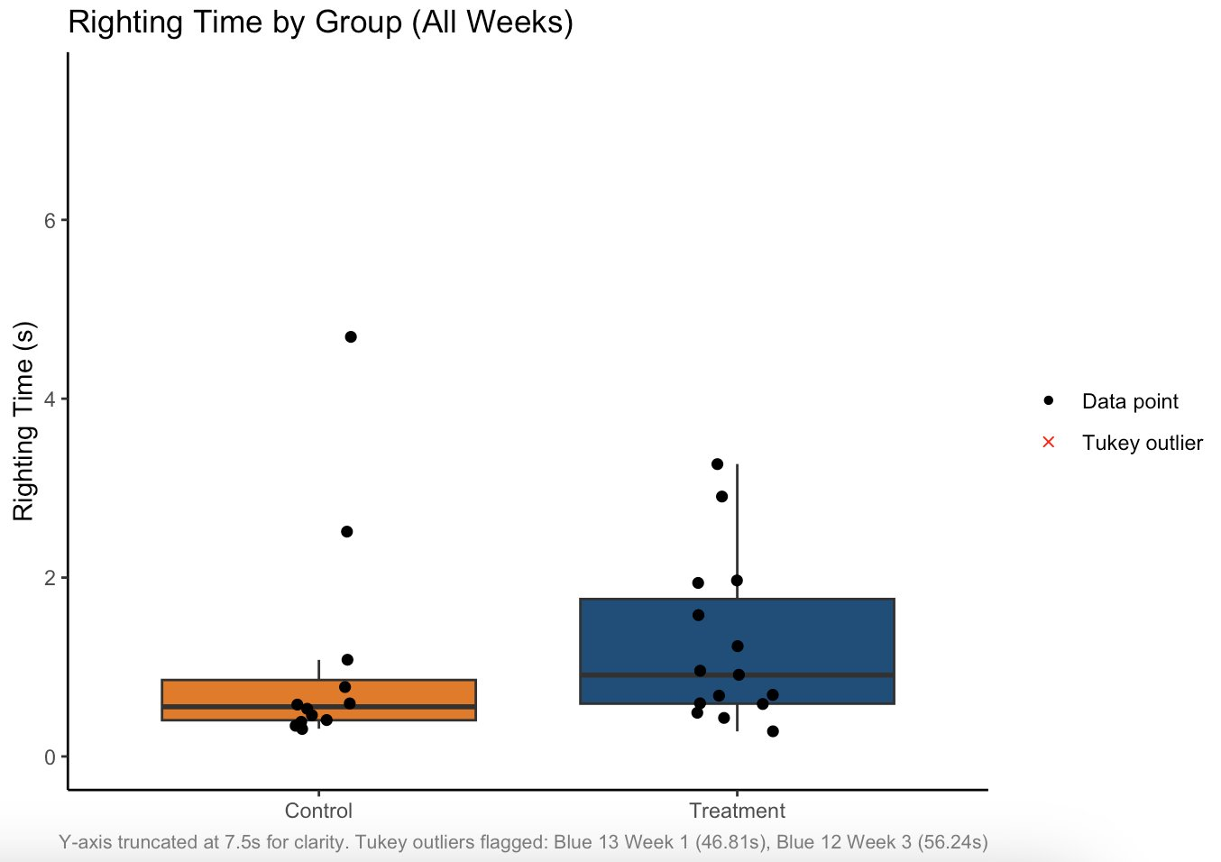
Behavioral Response
Noise-exposed crabs generally required longer to right themselves.
2 outliers with extreme times excluded
Largest treatment effect observed among all measured variables.
Extreme righting times much more frequent in treatment individuals.

Slide 8
Righting Time in simple terms
CONTROL
0.53s
median righting time
NOISE-EXPOSED
0.94s
median righting time
+75%
longer than control
EXTREME OUTLIERS (treatment only)
46.8s & 56.2s
vs. control max of 4.7s

Slide 9
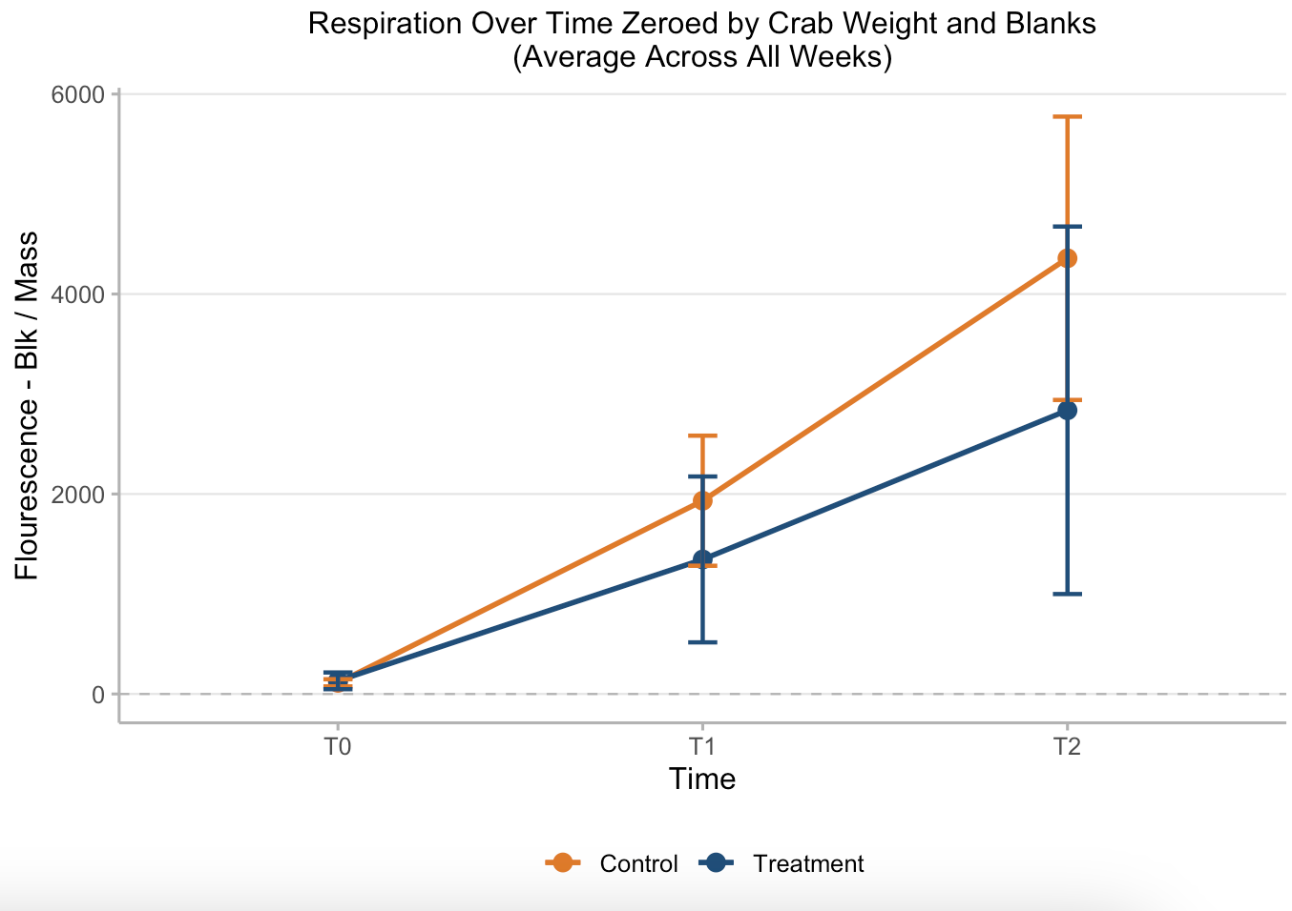
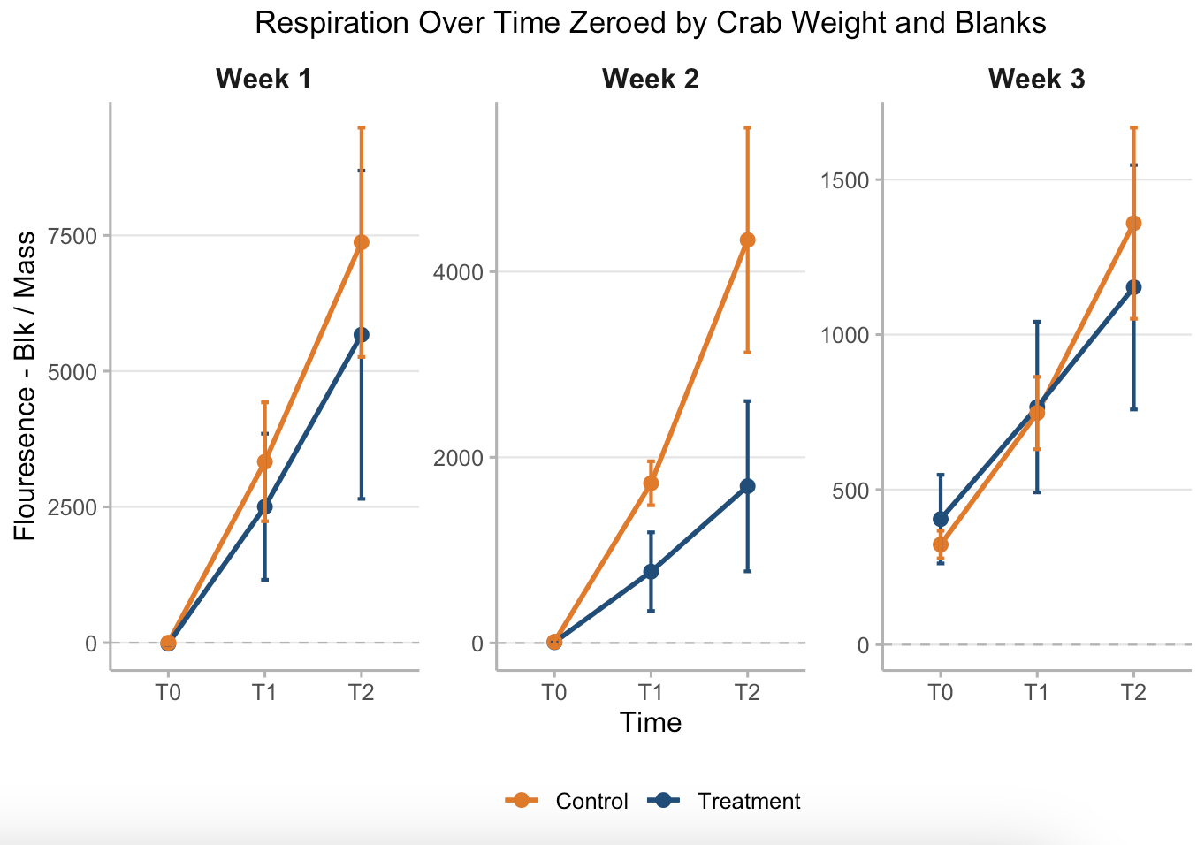
Respiration Results
Respiration increased over time in both groups
Control crabs showed higher oxygen consumption when averaged across all weeks
Weeks 1-3 all display slightly different results
No statistically significant treatment effect

Slide 10

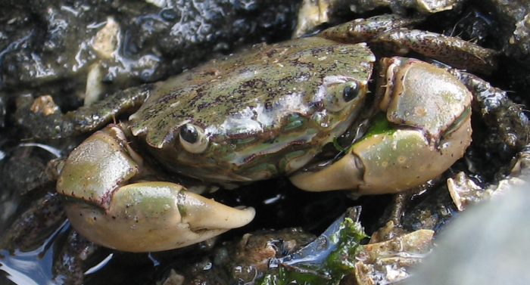
Key Results
Righting time increased in crabs exposed to treatment
Respiration showed no significant treatment effect (p > 0.05), but interesting visual trend
Glucose showed high variability between individuals
Behavioral effects were stronger than metabolic effects
3 molts in control (2 deaths), 0 molts in experimental

Slide 11
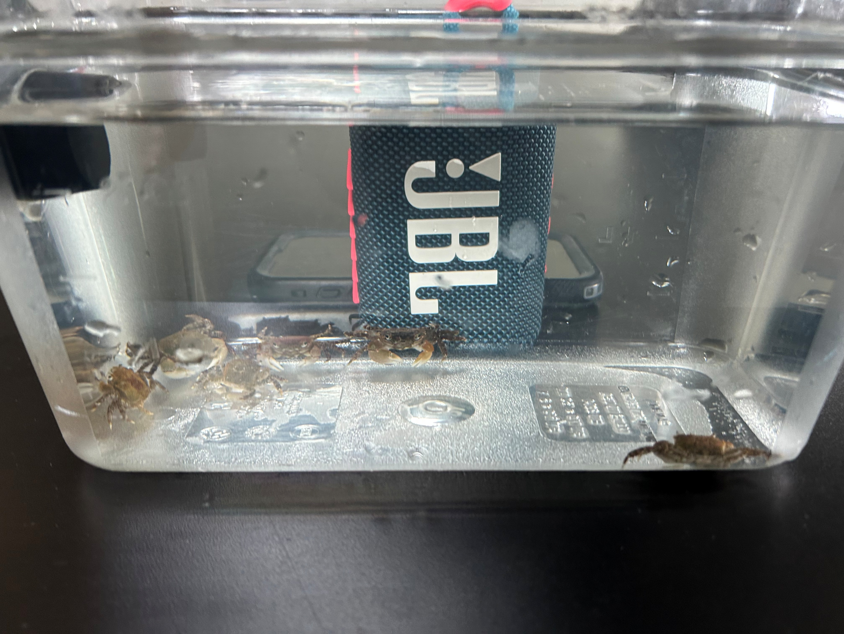
Limitations
Small sample size (decreased due to death and molting)
Short-term exposure only
Laboratory conditions may not fully represent natural environments
Only one noise type and intensity tested
Model organism tested and not Dungeness crabs

Slide 12
Conclusions
Noise exposure altered crab behavior
Respiration and glucose responses were limited
Small sample size hurts statistical power, but we hypothesize that we exceeded the acute stress response and these crabs were experiencing an exhaustive state

Slide 13
What This Means for Dungeness Crab
Dungeness Fishery
HOW OUR RESULTS CONNECT
$110M WA fishery value 2024-25
-44% catch decline over 2 seasons
H. oregonensis shares body plan, physiology, and habitat with the Dungeness crab making it a valid proxy organism
Next step: Replicate with larger n, longer exposures, varied noise types, and direct testing on Metacarcinus magister to inform WA noise ordinances
Noise-induced suppression during spawning could reduce Dungeness recruitment
Impaired righting response = easier prey for invasive green crabs
Coastal concert/event noise is currently unregulated in WA
These results justify including noise in environmental impact assessments for nearshore events

Slide 14
Future Implications + Steps
Warrants further investigation (intensities + noise types)
Future studies will inform noise regulations for coastal events and development
Incorporate noise pollution into environmental impact assessments
Improve understanding of human impacts on intertidal ecosystems
Support future fisheries and habitat management decisions

Slide 15
Questions?

Slide 16
References
Jalkanen, J.-P., Johansson, L., Andersson, M. H., Majamäki, E., & Sigray, P. (2022). Underwater noise emissions from ships during 2014–2020. Environmental Pollution, 311, 119766. https://doi.org/10.1016/j.envpol.2022.119766
Holt, M. M., Emmons, C. K., Dziak, R. P., Mellinger, D. K., & Haver, S. M. (2026). Underwater acoustic monitoring desktop study: A collaborative initiative between Port of Seattle (PoS) and the National Oceanic and Atmospheric Administration (NOAA) (NOAA Technical Memorandum NMFS-NWFSC-207). NOAA. https://doi.org/10.25923/g589-6539
Aimon, C., Simpson, S. D., Hazelwood, R. A., Bruintjes, R., & Urbina, M. A. (2021). Anthropogenic underwater vibrations are sensed and stressful for the shore crab Carcinus maenas. Environmental Pollution, 285, 117148. https://doi.org/10.1016/j.envpol.2021.117148
•Birch A, Cox KD, Murchy KA, Emry S, Harley CDG. Shipping noise tolerance in invertebrates: A case study of the shore crab Hemigrapsus oregonensis. PLoS One. 2025 Aug 12;20(8):e0329098. doi: 10.1371/journal.pone.0329098. PMID: 40794759; PMCID: PMC12342237.

